Slide 1
Cable Blowing
35 Year Historical Review
Willem Griffioen, Michael van Moppes, Vitor Goncalves
International Wire & Cable Symposium, Providence (RI), October 10-13, 2022

Slide 2
Problems in 1986
Dutch PTT had tough job to replace trunk network by optical cables
Cable lengths of 2.1 km had to be installed (without splice)
But pulling length was max 300 m, sometimes much less
Flawless installation: needed to reduce section length to 175 m
Installation by mid-point buffering and Figure-8 capstans in tandem (2 x 6 x 175 = 2100 m)
Lot of work, synchronisation problems, took 2 days

Slide 3
Problems in 1986
And sometimes this happened overnight
Not aware that there was no copper in the cable
(in 1986 optical cables were still new)

Slide 4
R&D Lab consulted
Head offices PTT asked their R&D Lab what could be wrong
No explanation found with calculations based on friction and on capstan effect
Capstan effect = every bend gives factor increase in pulling force
Cable stiffness effect in bends was the suspect. No theory known, so was developed
But:
Could not explain the short pulling lengths

Slide 5
Cause found
Straight sections between bends not straight
Duct undulations also represent direction changes
Capstan effect like in bends
Theory developed
Observed undulations explain limited pulling length!
Also theory effect cable stiffness in undulations developed
Again cable stiffness effect is small
So, it is the capstan effect that causes the short pulling length
5

Slide 6
Thinking of a solution
Blown fibre already existed (since 1982, British Telecom)
Installation with help of high speed air flow
Distributed air drag forces locally compensate friction
No axial pulling forces, so no capstan effect
That was what we needed!
But, blown fibre known as limited to flexible and lightweight fibre members
However, calculation with the new theory said that blowing cables might be possible
(the effect of cable stiffness is smaller than was thought)

Slide 7
Time to give it a try
Test trajectory (4 loops) in Kootwijk (PTT)
Here Figure-8 capstans were tested earlier
4 of them in tandem operation
Calculated that 2 loops can be blown
So proposed to do a test

Slide 8
Time to give it a try
No one believed blowing would work (except the chief)
And it was claimed that it was tried already earlier
(but that was done the wrong way)
What we need
With plug in front of cable there is no high speed airflow
And cable must be pushed into pressure zone (hard work ,4 men in turn , complaining)
It worked! I calculated 2 loops, but it made it to the end of the 4 loops!

Slide 9
Why did we reach twice the calculated distance?
Air compressible, expanding towards end duct, gaining velocity
So air drag forces increase towards end
We pushed harder than needed to insert cable in pressure zone
Additional pushing force in synergy with air drag forces
  First air drag forces are half what is needed to overcome friction
  Helped with pushing assistance (for that you need cable stiffness!)
  Pushing force has a long action (only part used to overcome friction)
  Pushing force decreases → airflow takes over
  Result: twice the blowing distance
  In calculation and in practice
  Basis for patent (1987)
  And time to make a prototype machine

Slide 10
Prototype
First machine tested in field installation
700 m blowing + 350 m pulling
Prototype was kept, no return to lab
Cable of 2.1 km could be installed in 1 day
3 more machines produced
Tested in field installation, 4 in tandem
Much higher production
30 more machines produced
(ready 4 months after first hand pushing)
7 crews in competition for max production (1987)
One crew even reached 6 cables of 2.1 km in 1 day!
  8 km production in 1 day not an exception

Slide 11
Advantages blowing over pulling
1 step operation, no winch rope to install
Equipment and labour at 1 side trajectory
Winch pulling, what we miss
Low forces (no cable wear)
Long installation distance
Also in trajectory with bends
No synchronization problems
High speed
Blowing is the solution
5.3 km blowing record
180 m/min max speed
12 km installed in one day

Slide 12
First operation outside The Netherlands
First cables blown outside The Netherlands in Spain (1990)
Optical link from Madrid to Sevilla (for World Expo 1992)
Project awarded to NKF
It was NKF’s cable that was blown in The Netherlands
Selling argument: these cables can be blown
(but almost all cables can be blown)
Project done with machines from Plumettaz SA (CH)
(worldwide exclusive licence from Dutch PTT)

Slide 13
Microduct cabling
Second Revolution
Loose bundles of microducts in protected duct introduced in The Netherlands in 1999
The team: KPN (PTT), NKF (now Prysmian), Mainetti (now Emtelle), Eden and Plumettaz
Cables with reduced diameter (9.6 mm → 3.9 mm) blown into 7/5.5 mm microducts

Slide 14
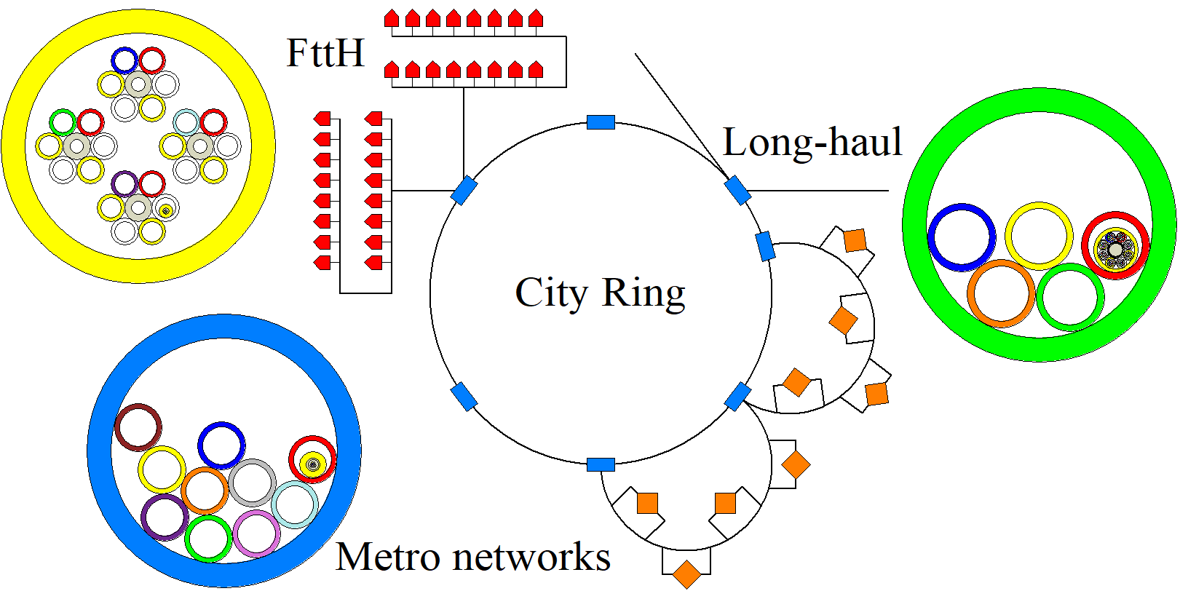
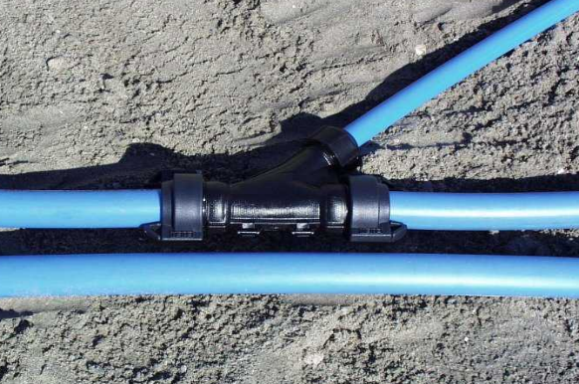
Microduct cabling
Advantages microducts
  Compact, high fiber density
  Pay as you grow
  Serial upgradable
    Without splice
    Just push-pull connectors
  Parallel upgradable
    Easy branching
    Any place any time, without splice
    Just push-pull connectors
  Redundant connections
    Half the fibre count
    Left and right “woven into each other”
      No left and right cable with full fiber number, use empty microducts other side
14

Slide 15
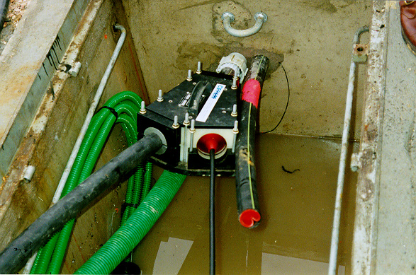
Override blowing
Ducts occupied with cables can still be upgraded with new cables or microducts (also when officially fully occupied)
  Makes use of a special Y-connector
  Can save a lot of money (avoid digging again for upgrade)!
  Less blowing distance
    A lesser problem when first blowing additional microducts
    Easy to connect by push-pull connectors (no need to buffer)
    Cables installed over long length in “upgraded” environment
  Example: Old “fully occupied” KPN duct (with first blown cables)
    32/25 mm duct with 9.7 mm cable (6 fibers)
    Paraffin oil became tacky, only 200 m blowing length
    Blow in 2 microducts 10/8 mm
    Blow 2 cables with 96 fibres over length of 1500 m
    Upgrade by 3200%

Slide 16
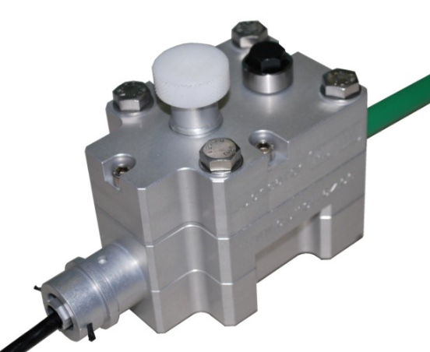
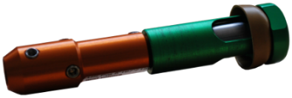
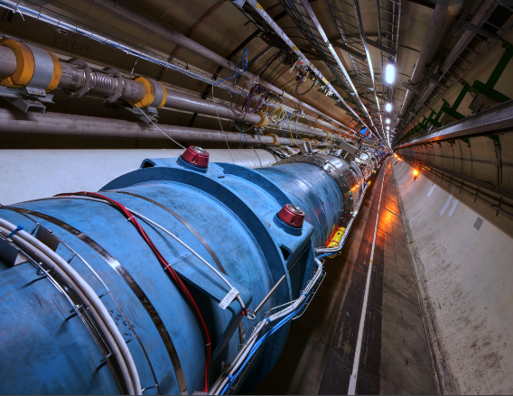
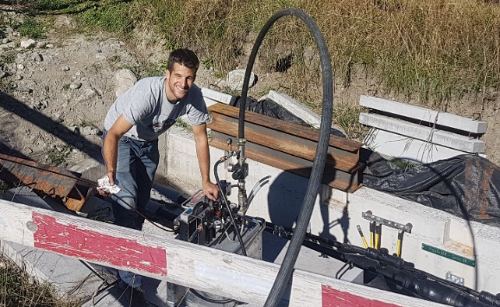
Cable blowing records
Blowing length in 1987 was 700 m
Today better cable construction, materials and lubricants
No metal, minimized bending memory
Better lubrication methods (cable lubricator)
Compressor after-coolers, sonic heads
Record blowing lengths (in one shot)
In 2004 a record length of 3.6 km was reached (CERN)
Today even 5.3 km reached (Swiss mountains)

Slide 17
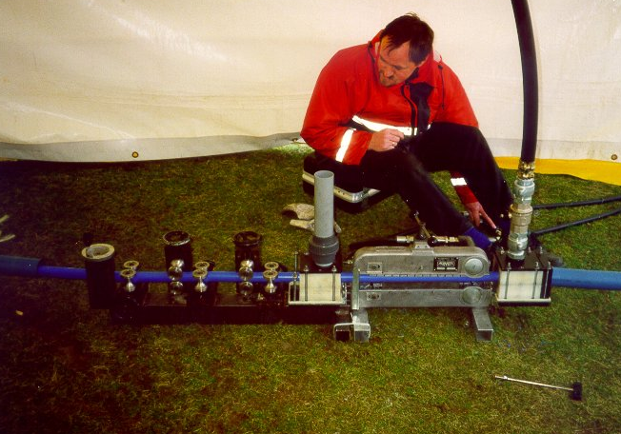
Cable blowing limits
“My cable is too heavy for blowing”
That is often heard, still today
However, the first cables blown were just the standard cables, optimized for pulling
Also very heavy cables can be blown (record 3.8 tons!)
Optical cables up to 6912 fibers
The only limit is the duct: 63/50 mm (1 inch)
Because of safety
But, cable blowing allows other cable constructions:
  Less strong, more compact
  Even better blowing properties
  And more fibers

Slide 18
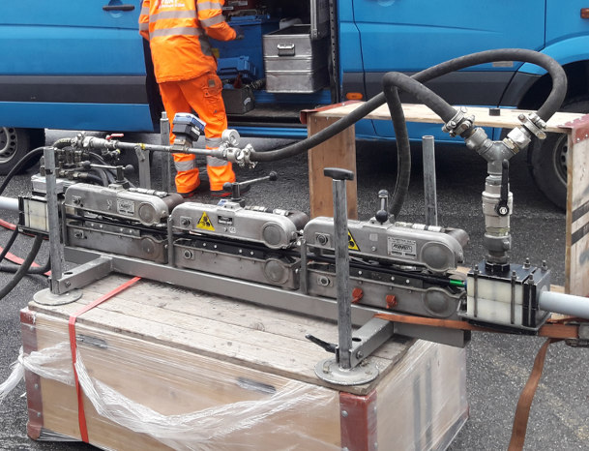
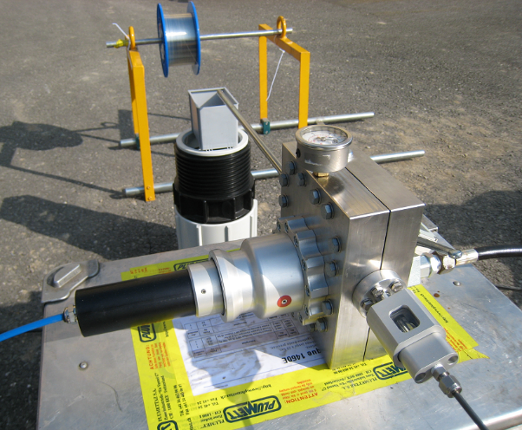
Cable blowing spin-off with water
Water as propelling Fluid instead of air: Floating
  Additional benefit from buoyancy
  And larger ducts (up to 125/102 mm) because of higher viscosity
  Even longer installation lengths (record 12.3 km!)
    Again Switzerland, with triple pusher
    Cable came out of duct soon after water
  And still more possible when balancing densities
    Cable density by design
    Propelling fluid brine, e.g. water saturated with NaCl
  Sharp bends and cable stiffness last friction contributors
  If that also optimized then why not 100 km?
    A 30 km project is in preparation
  Also bare fibers in small steel tubes can be floated in

Slide 19
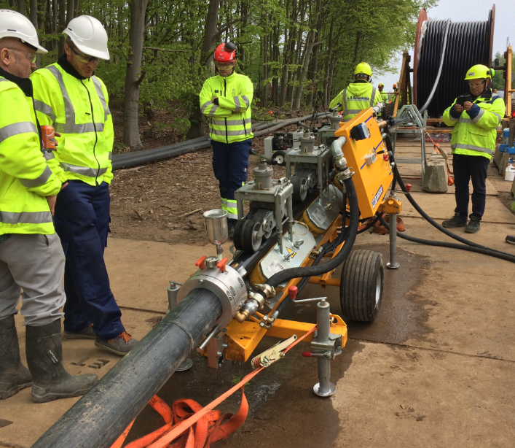
Cable blowing spin-off with water
For ducts still larger than 125/102 mm (for energy cables) large water pumps are needed to maintain the flow to reach sufficient water pressure → no limit in duct (pipe) size
In that case a pig is used to limit the flow (WaterPushPulling)
  All force from fluid now concentrated as pulling force at pig
  Capstan effect is back
  But, still long lengths (up to 3.3. km) reached, because of
    Buoyancy
    Synergy of pushing and pulling
    Duct trajectories are usually without too many bends and undulations
After WaterPushPulling the cable can be FreeFloated
  Loose from the machine, by water flow only (like tube post)
  To any suitable location!
  Unlimited distance!

Slide 20
Conclusions
Review given of 35 years of cable blowing history
Started in 1987 at Dutch PTT because of pulling problems
  Cause found, opened possibility to merge with British Telecom’s blown fiber technique
  Became standard technique in Netherlands within 4 months after first (manual) tests
  Exclusive worldwide license to Plumettaz SA
Now worldwide THE standard technique to install optical cable in duct
Blowing distance increased from 700 m to 5.3 km record today
  Better cable construction, materials and lubrication
Triggered microduct cabling
Huge cost savings with override blowing
Spin off when using water instead of air (higher viscosity → larger ducts)
  Floating: because of buoyancy almost unlimited length (record now 12.3 km)
  Also WaterPushPulling (with pig) and FreeFloating for still larger ducts

